Slide 1
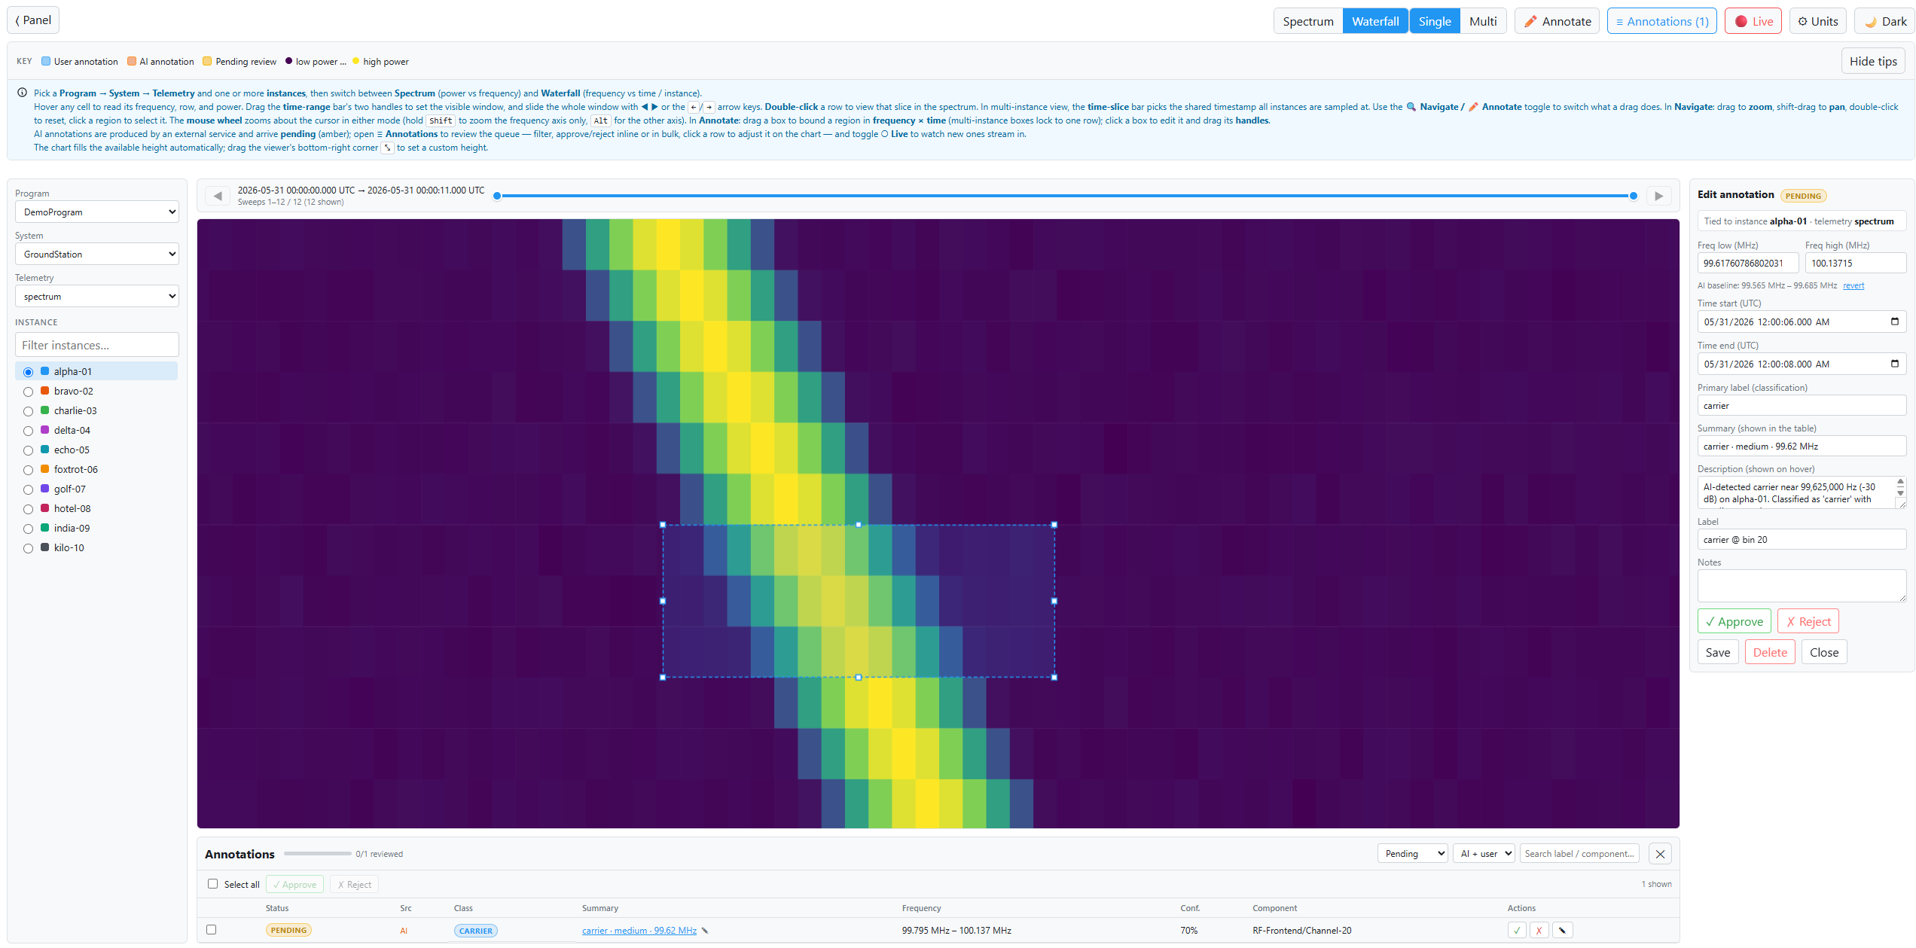
RF Spectrograph Mode with temporal annotation (per test)

Slide 2
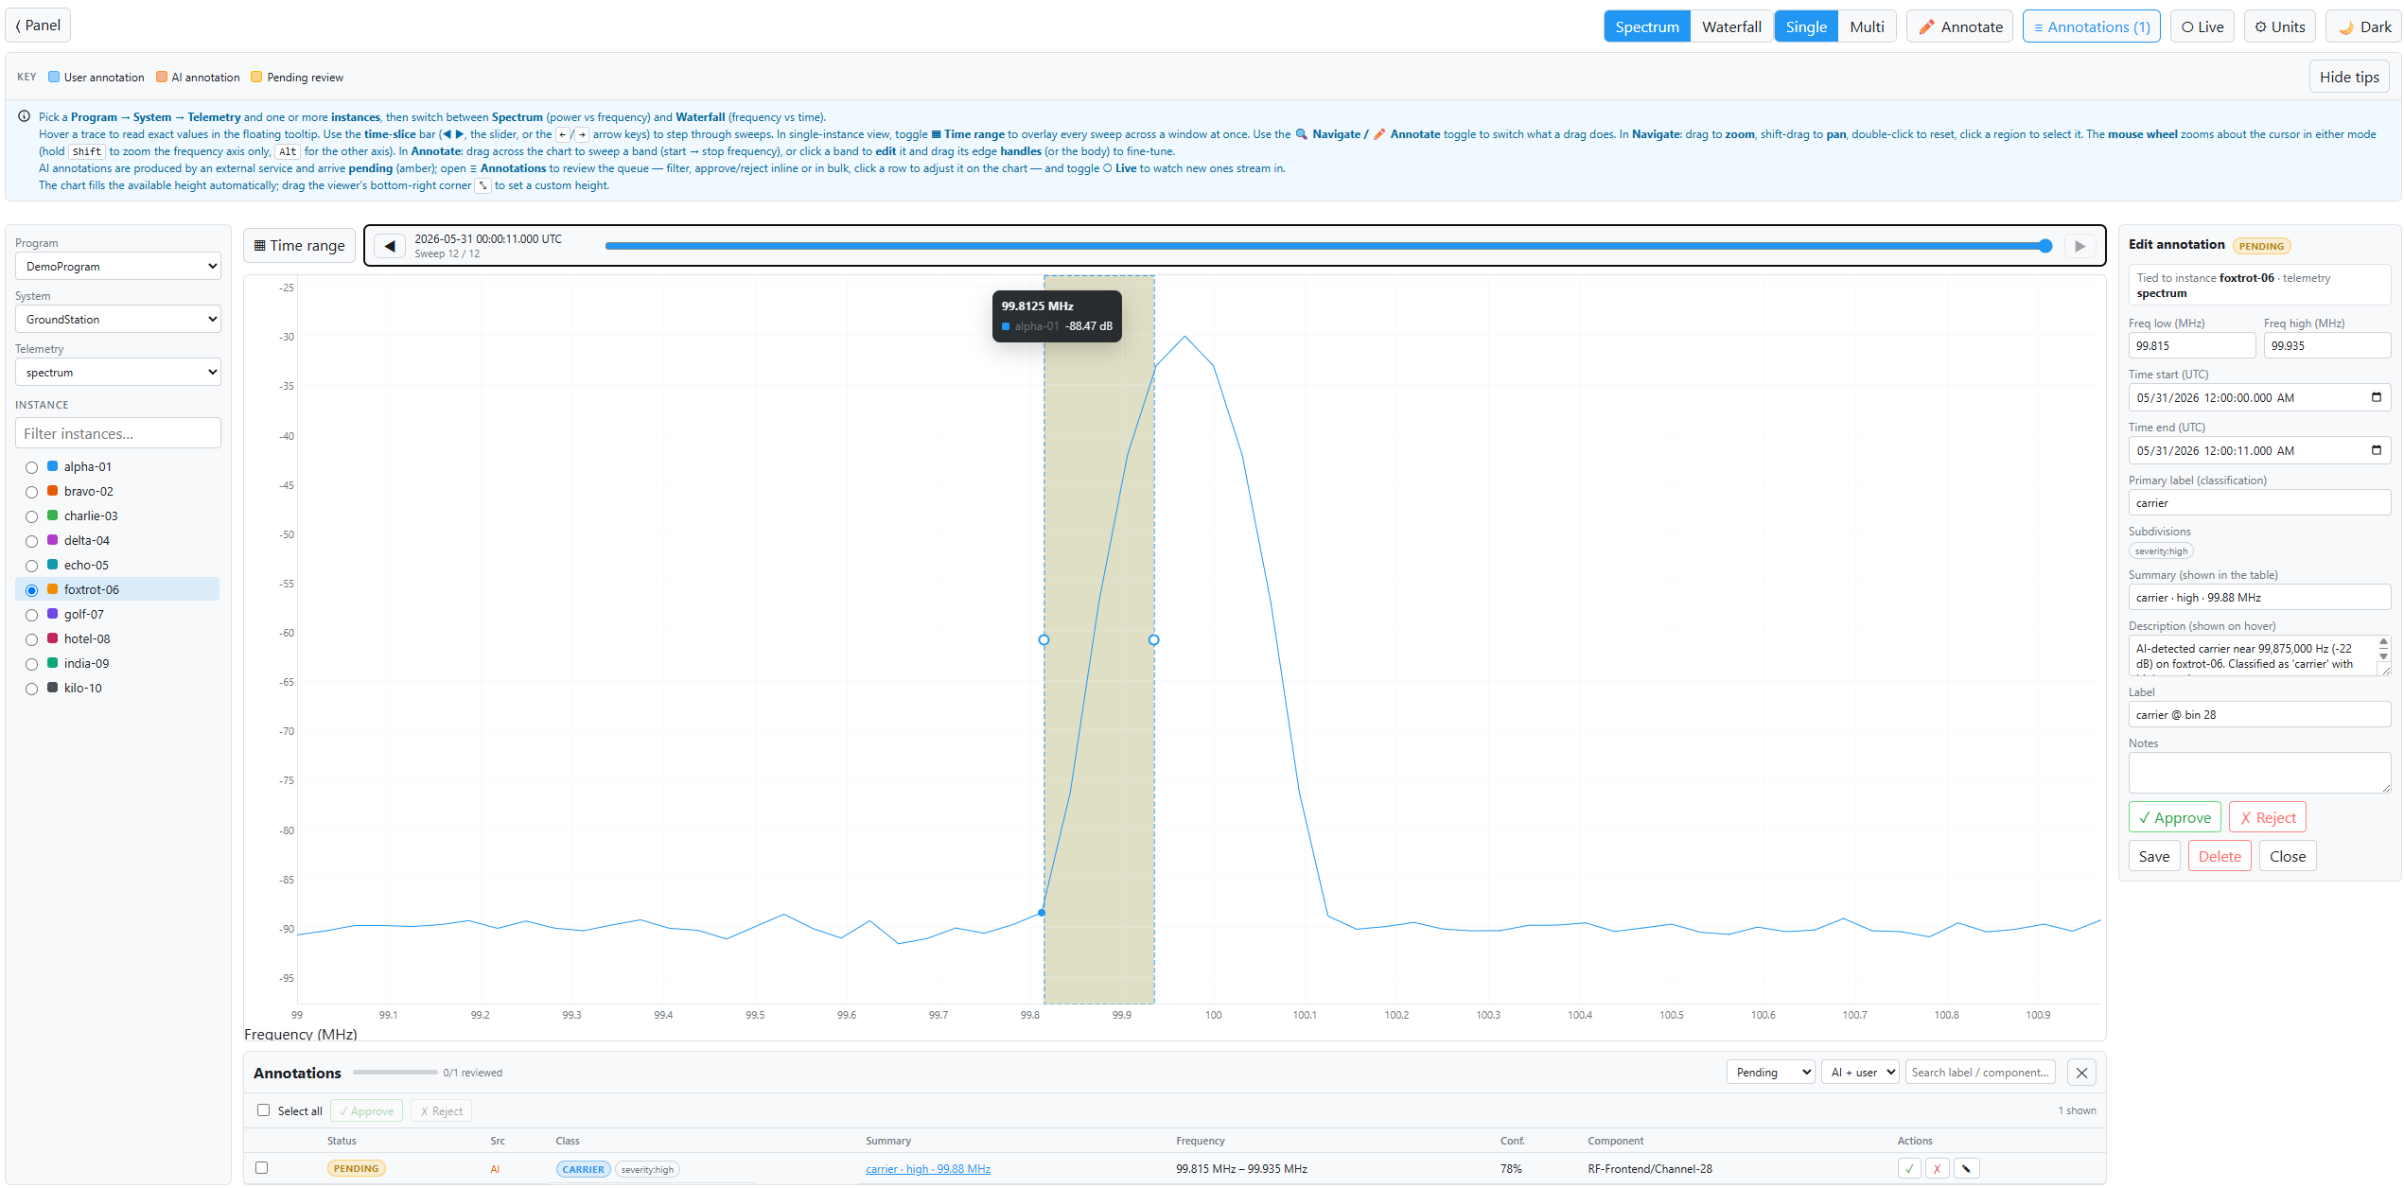
Spectrum Mode

Slide 3
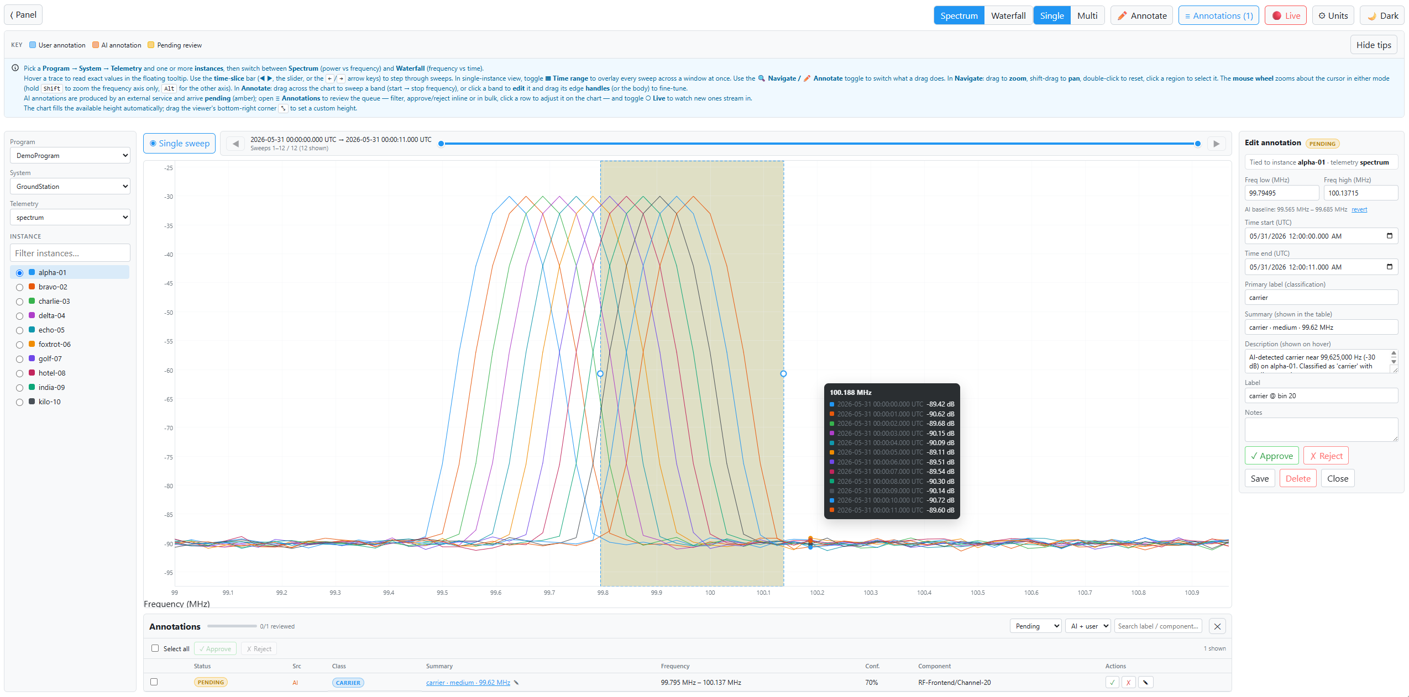
Multi-View of Telemetry in Spectrum Model, with freq-annotation

Slide 4
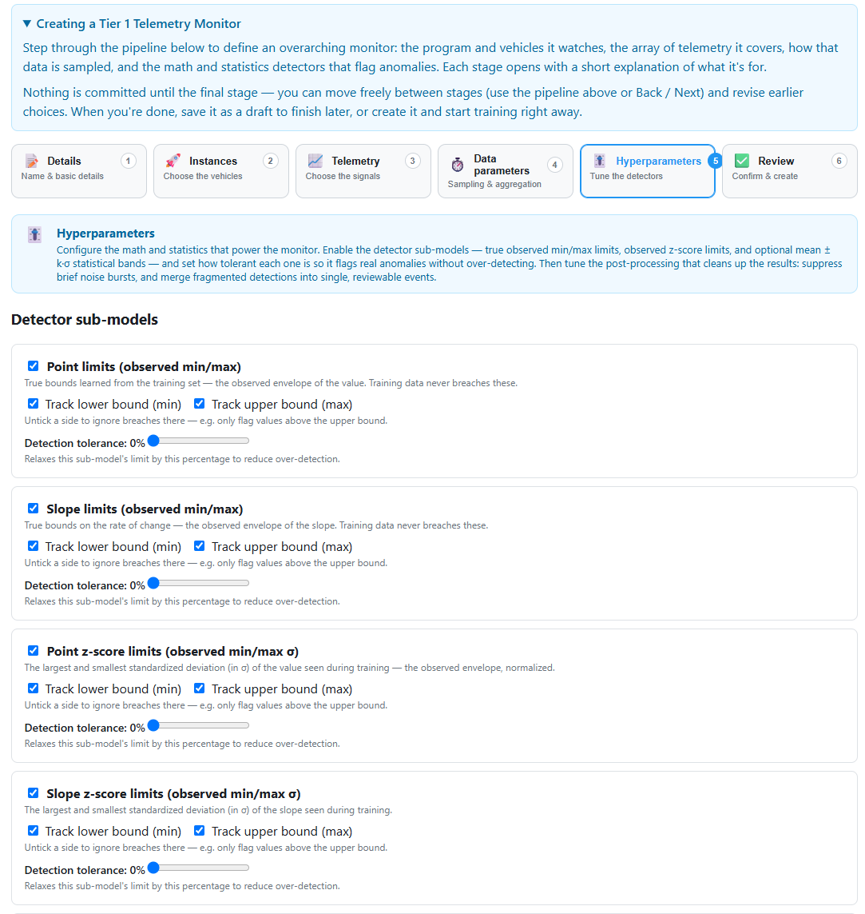
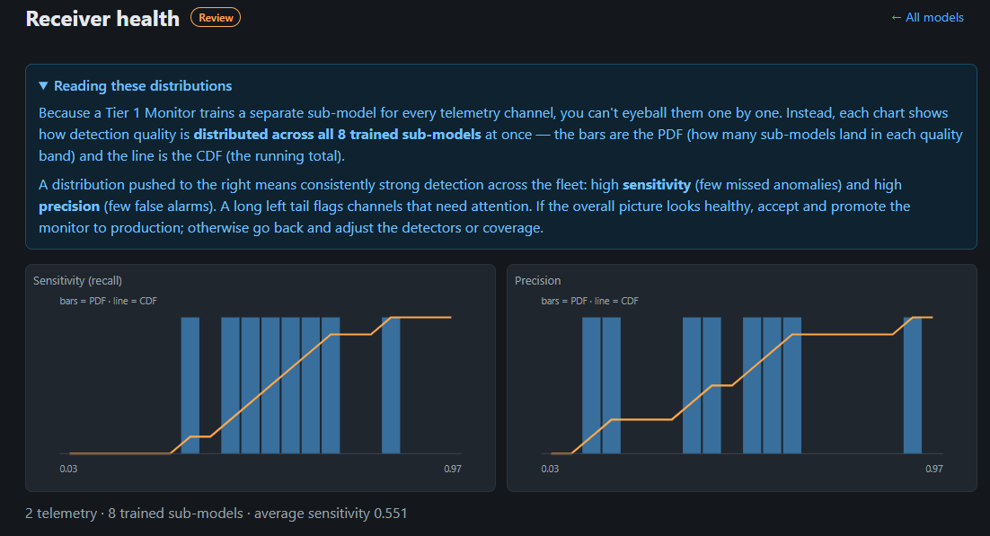
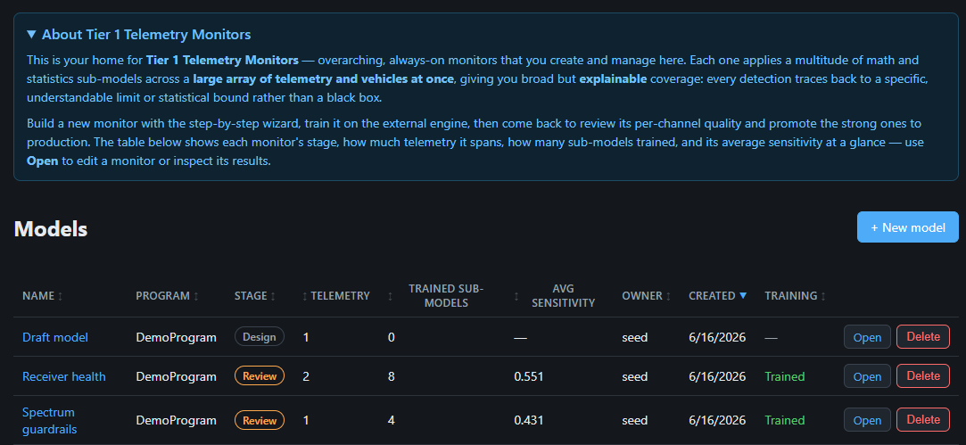
(U) Tier 1 Model UI
(U) Screen samples from new UI/UX to create, manage, and review broad-coverage Tier-1 models

Slide 5
(U) Advanced Anomaly Detector Algorithms (Factory DGX; in-progress)
Detector | Registry key | Algorithm family | Intro'd | Realistic tier | Multivariate | Per-step scores
RollingMeanDetector | rolling_mean | Classical residual (z-score) | Phase 0 | CPU | ✓ | ✓
PatchTSTMAEDetector | patchtst_mae | Channel-independent patch transformer + MAE | Phase 2 | 3080 / A5000 / H200 | ✓ | ✓
AnomalyTransformerDetector | anomaly_transformer | Prior-vs-series association (KL) | Phase 2 | 3080 / A5000 / H200 | ✓ | ✓
DCdetectorDetector | dcdetector | Dual-attention contrastive | Phase 2 | 3080 / A5000 / H200 | ✓ | ✓
ChronosDetector | chronos_zero / chronos_lora | T5-based forecasting foundation model | Phase 3 | A5000 / H200 | ✓ (per-channel) | ✓
MoiraiDetector | moirai_zero / moirai_lora | Patched encoder-only forecasting foundation | Phase 3 | A5000 / H200 | ✓ | ✓
MOMENTDetector | moment_zero / moment_lora | Patched encoder + recon foundation | Phase 3 | A5000 / H200 | ✓ | ✓
SatTSFMDetector | sat_tsfm | Channel-flexible Sat-TSFM (from-scratch foundation) | Phase 4 | A5000 / H200 / 8x H200 | ✓ | ✓
SubsystemMoEDetector | subsystem_moe | Per-subsystem Mixture-of-Experts | Phase 4 | A5000 / H200 | ✓ | ✓
PINNResidualDetector | pinn_residual | Physics-residual wrapper (subtract analytical prediction) | Phase 4 | any | ✓ | ✓
SatTSFMMultiTaskDetector | sat_tsfm_multitask | Sat-TSFM + 4-head multi-task (AD + fault + RUL + mode) | Phase 6 | A5000 / H200 / 8x H200 | ✓ | ✓
SequenceTransformerDetector | sequence_transformer | BERT-style MLM over discrete command tokens | Phase 8 | 3080 / A5000 | n/a (discrete) | ✓
OperatorFingerprintDetector | operator_fingerprint | Mahalanobis distance vs per-operator baseline | Phase 8 | CPU / 3080 | ✓ | per-window
ThermalPinn | thermal_pinn_torch | Trainable thermal PINN (1D conduction) | Phase 9 | A5000 / H200 | ✓ | ✓
AdcsPinn | adcs_pinn | Attitude PINN with 3 SO(3) integrator variants | Phase 9 | A5000 / H200 | ✓ | ✓
SatMultiModalDetector | sat_multimodal | Three-stream (telem + cmd + log) cross-modal MAE | Phase 10 | A5000 / H200 / 8x H200 | ✓ | ✓
Table is (U)
(U) Time-series-foundation-model training candidates, currently being trained at factory, ETC Aug ’26. New, algorithms will provide advanced AI coverage in future HW configuration or GPU-enabled servers

Slide 6
(U) Correlation Algorithms In-Progress
Name | File | Idea | Key params
RollingCorr | model_rolling_corr.py | Frobenius norm of (window corr − baseline corr) | window
MahalanobisCorr | model_mahalanobis_corr.py | Mahalanobis distance in PCA-reduced correlation-eigenvalue space | window, k, pca_dim, stride
PCA_Full | model_pca_eigen_shift.py | L2 drift of explained-variance spectrum (full SVD) | window, k
PCA_Randomized | model_pca_eigen_shift.py | …same, randomized SVD | window, k
PCA_Incremental | model_pca_eigen_shift.py | …same, incremental PCA | window, k
PCA_Reconstruction | model_pca_reconstruction.py | MSE of reconstructing each window from trained PCA subspace | window, k
GraphCorrShift | model_graph_corr_shift.py | L1 change in |corr| adjacency vs baseline | window
DeepGraph_GNN | model_deepgraph_gnn.py | GraphConv autoencoder reconstruction error (optional: torch) | window, epochs, corr_threshold, hidden_dim, train_stride, num_train_windows, use_cuda, lr
CorALS | model_corals.py | Placeholder (returns zeros) for a future model | —
Table is (U)
(U) Hidden correlation training candidates, currently being evaluated. All passing algorithms will be added to Infrared AI Library and exposed via API to Agentic engines to automatically identify “What components are acting differently in [time-window]”

